Slide 1
Jeffry A. Frieden • David A. Lake • Kenneth A. Schultz
World Politics
Interests, Interactions, Institutions
THIRD EDITION
Chapter 4
Domestic Politics and War
© 2016 W. W. Norton & Company, Inc.

Slide 2
Domestic Politics and War
4

Slide 3
Domestic Politics and War
War Model Review
Domestic Politics and War
Institutions and War

Slide 4
Domestic Politics and War
War Model Review
Domestic Politics and War
Institutions and War

Slide 5
War Model Review
It is usually more rational to bargain than to go to war.
Notes:
This quick review of the war model will help you to see the difference that domestic politics can make in leaders’ calculations.

Slide 6
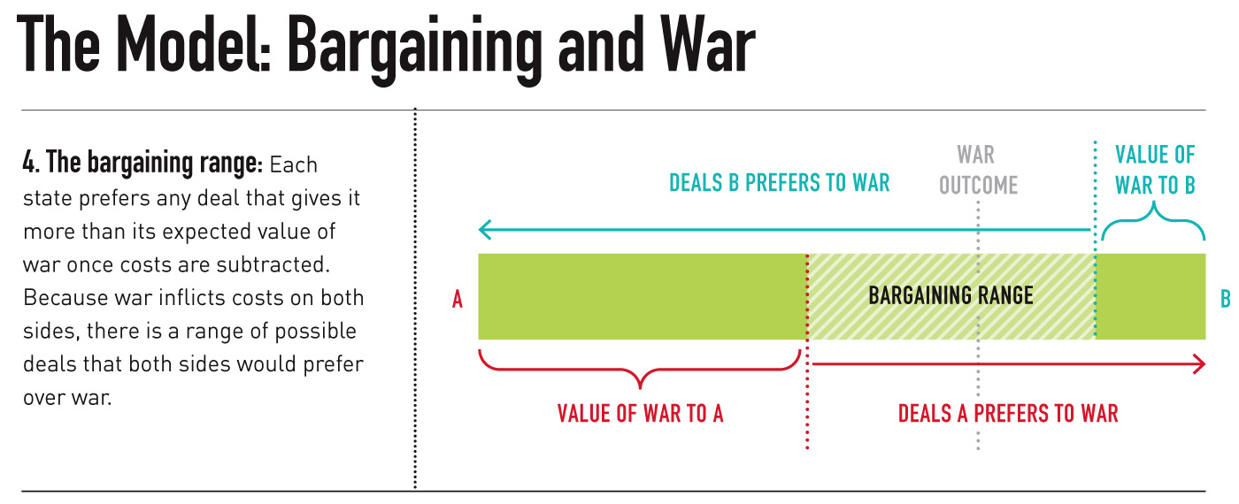
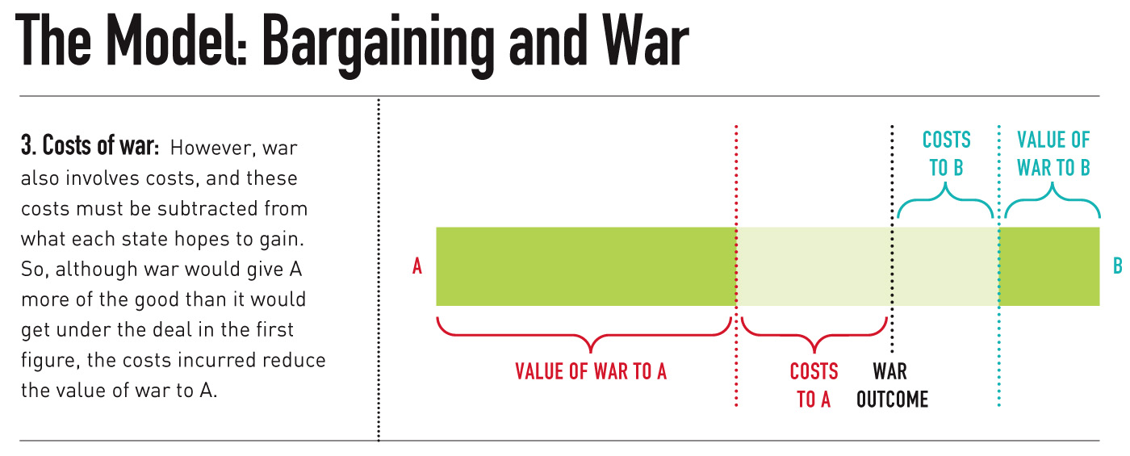
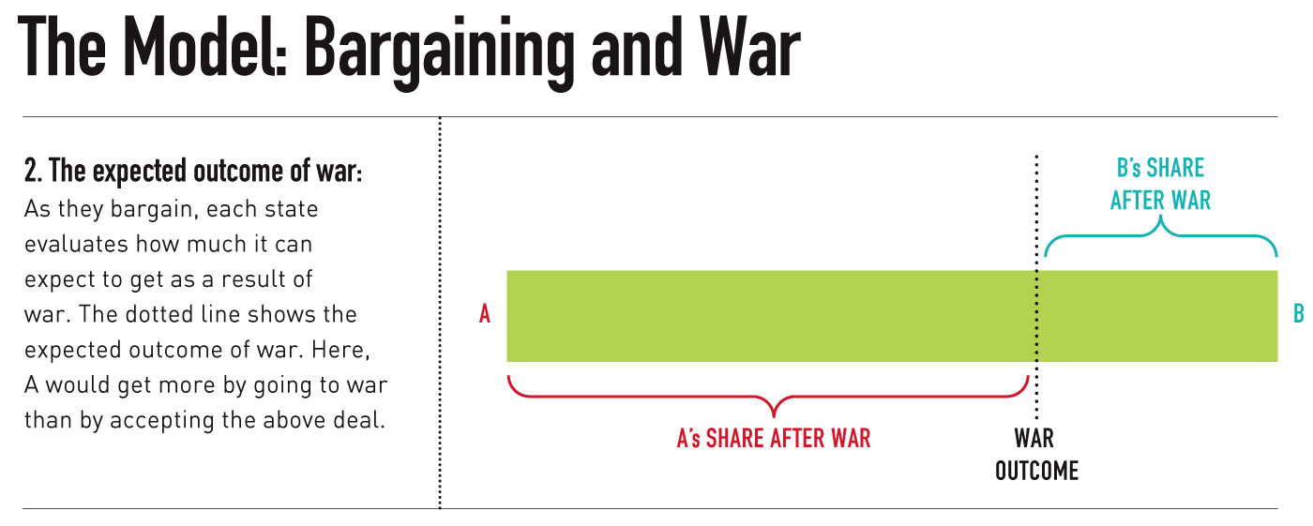
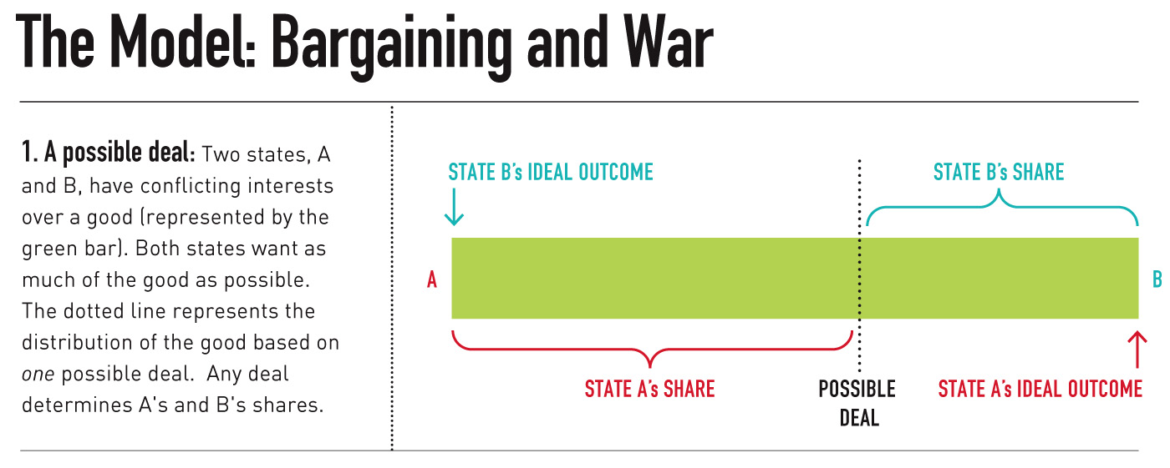
War as Outcome of a Failed Bargain
Notes:
Figure 3.2: Bargaining and the Status Quo
This model assumes that 1. war is costly, and 2. a settlement that both sides would prefer to war generally exists.
This figure depicts two states, A and B, bargaining over territory. The territory is the line. x shows a possible settlement between A and B—a new border, perhaps.
Under this deal, state A would get all the territory to the left of the possible deal line; state B would get all the territory to the right of the possible deal line. Both states prefer to receive more territory, so A wants a deal that moves the possible deal line as far to the right as possible so that A gets more territory. B wants a deal that moves the possible deal line as far to the left as possible so that B gets more territory.
Moving down to the second line (2), imagine that point the war outcome line is the expected division of territory if A and B go to war. The farther the war outcome line is to the right, the better for A. The farther the war outcome line is to the left, the better for B. However, war is costly.
The third line (3) depicts the costs of fighting. A’s costs are depicted by the costs to a section; B’s costs are depicted by the costs to b section. Notice that here the payoffs (the value of war to A and the value of war to B segments) are less than they would be in the absence of a war. This reflects the value of the good to A and to B, minus the costs of fighting.
The fourth line (4) shows us the bargaining range that both parties would prefer to war. This is the bargaining range. States would be better off settling anywhere in that range than they would be going to war. Striking a deal anywhere in this range would give both parties a better payoff than if they went to war. War imposes costs on both parties, so there is a bargaining range that both parties would prefer to war.

Slide 7

War as Outcome of a Failed Bargain: A Model of War
Notes:
Here is another, simple way to depict the strategic interaction between A and B, reinforcing the logic behind the notion of war as the outcome of a failed bargain.

Slide 8
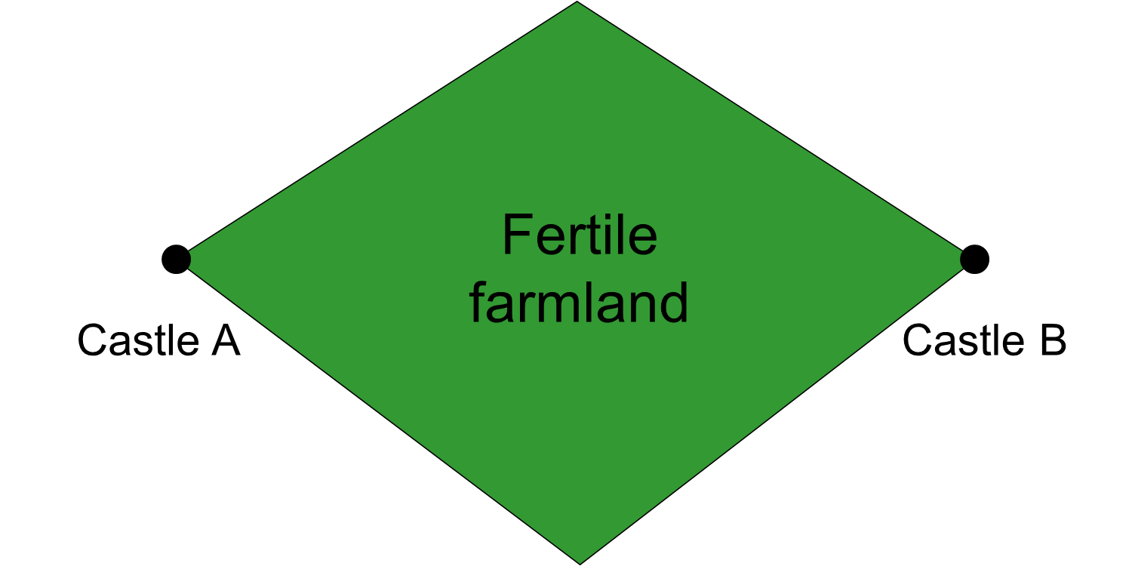
A Model of War
Notes:
“Fertile farmland” can represent anything of value over which states may fight.

Slide 9
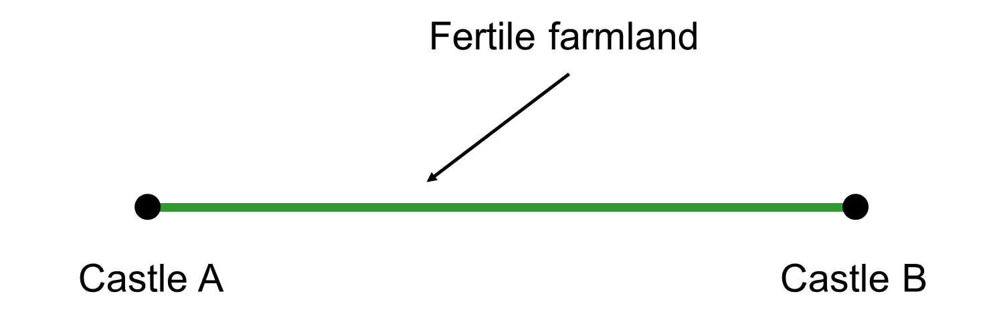
A Model of War
The object of contention (the green line) can be anything that states are in conflict over.

Slide 10
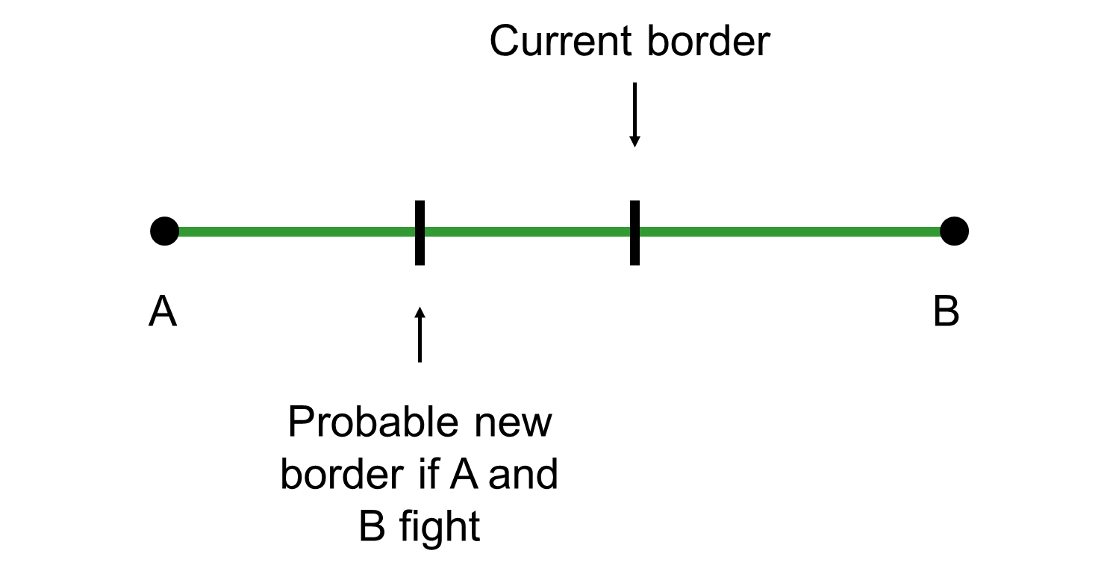
A Model of War

Slide 11
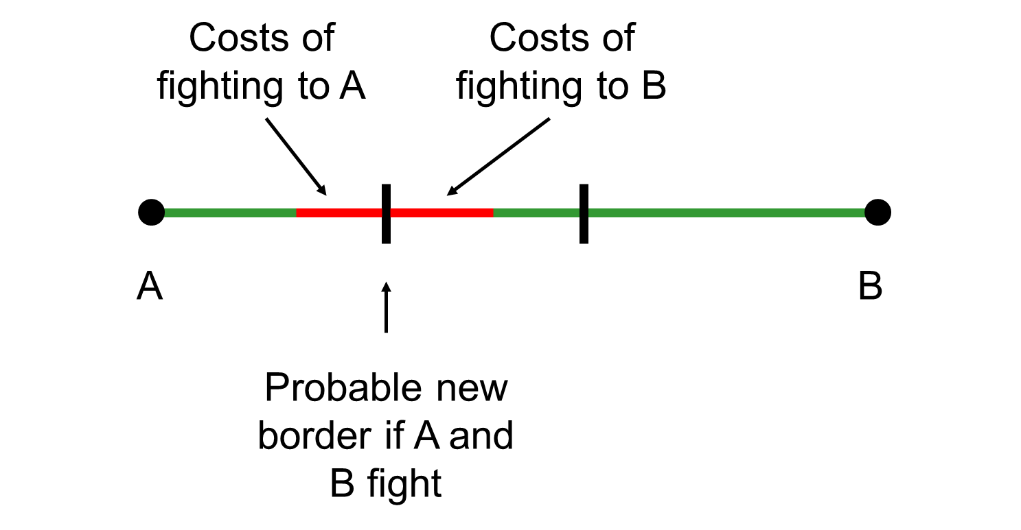
A Model of War
Notes:
War is costly: states must expend blood and treasure. The expected value of war must include costs.

Slide 12
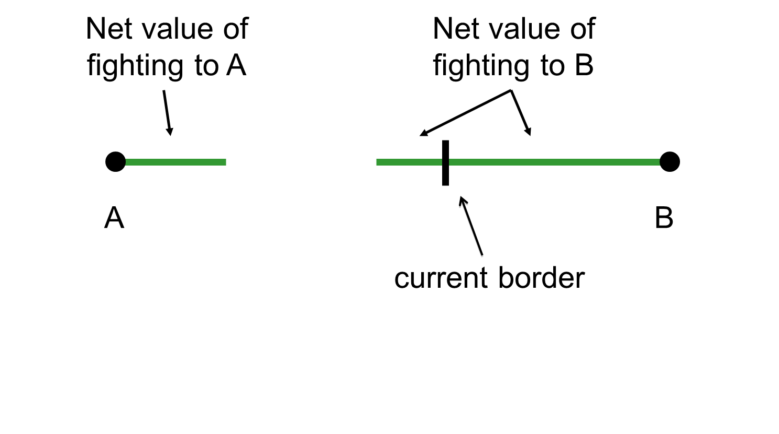
A Model of War
Notes:
Costs will be subtracted to estimate the net value of fighting.

Slide 13
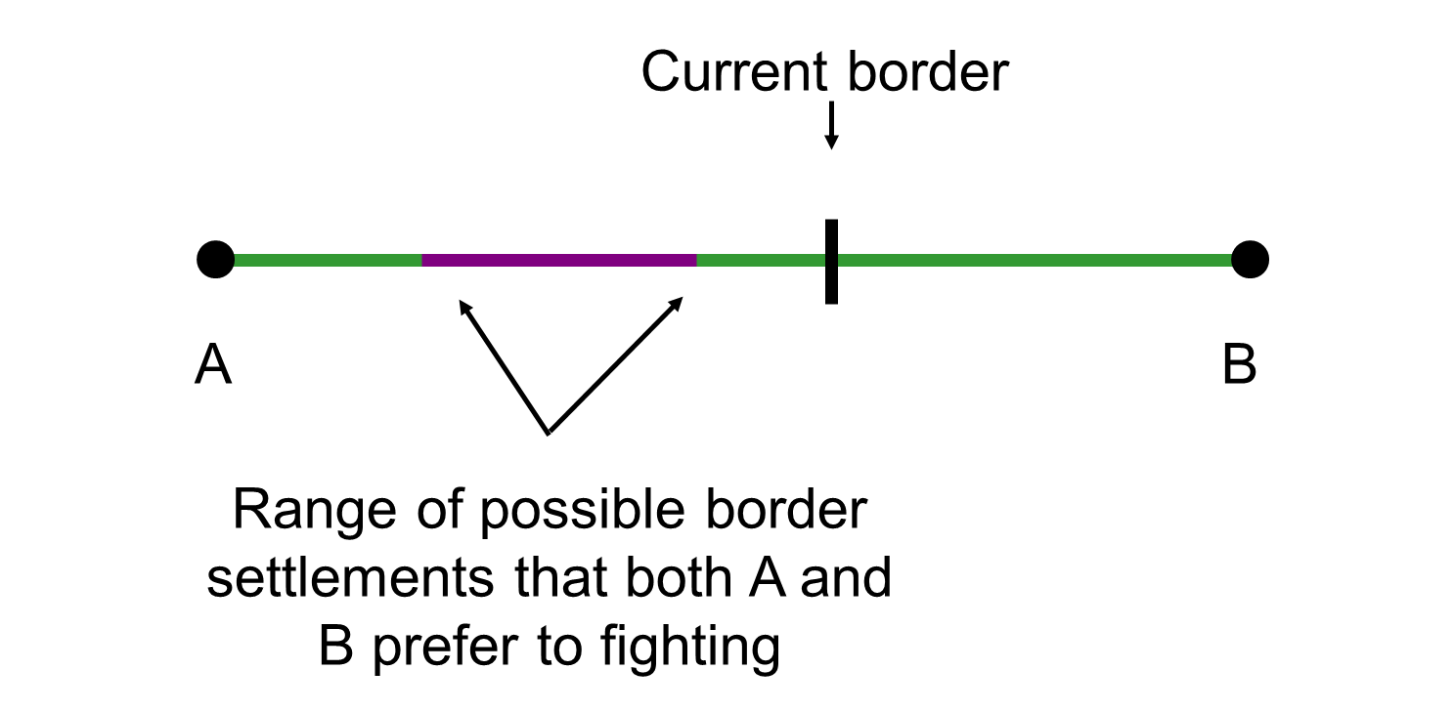
A Model of War

Slide 14
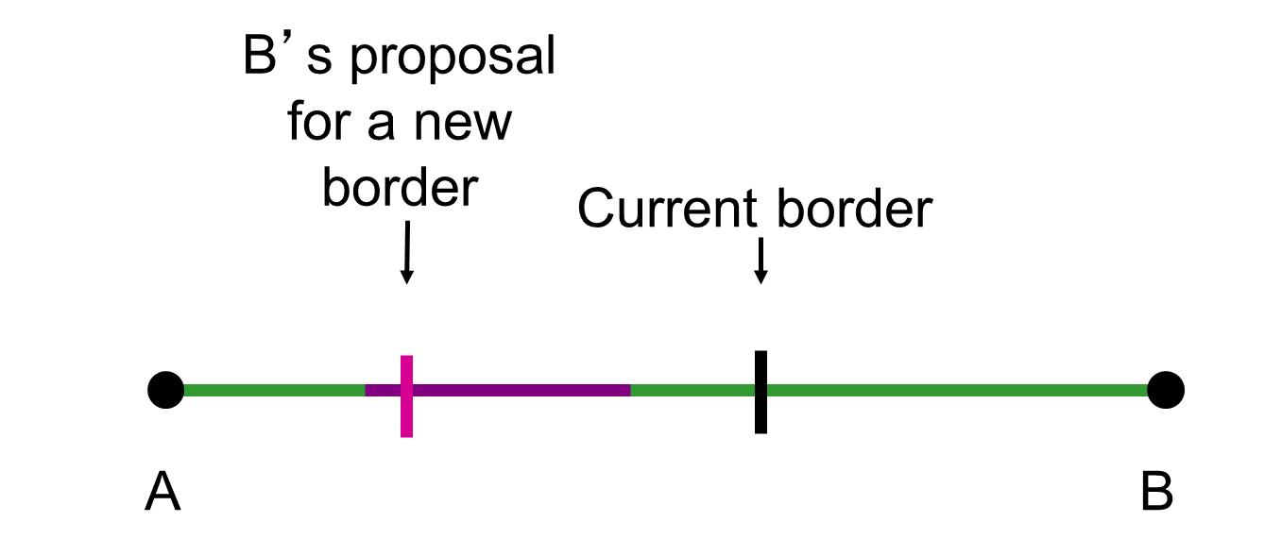
A Model of War
Notes:
B’s proposal for a new border is within the bargaining range that A and B would both prefer to war.
If B is threatening to go to war to move the border here, A would be better off accepting B’s proposal than fighting.

Slide 15

A Model of War
For any A and B, if
  war is costly, and
  the object of contention is divisible,
then there is always at least one negotiated settlement that A and B will both prefer to war.
Notes:
- Since war is costly, the best possible outcome would be to get the entire good without having to fight.
- Crisis bargaining is bargaining under threat of war. If there is always a bargaining range that both sides would prefer to war, then war itself is a puzzle.
- Why go to war? Is war a mistake?

Slide 16
Domestic Politics and War
War Model Review
Domestic Politics and War
Institutions and War

Slide 17
Domestic Politics and War
Interests
Leaders
Groups
Notes:
Interests may be national or particularistic. National security would be a national interest. Trade protection would be particularistic to the protected sector. Leaders and groups may have interests in war.

Slide 18
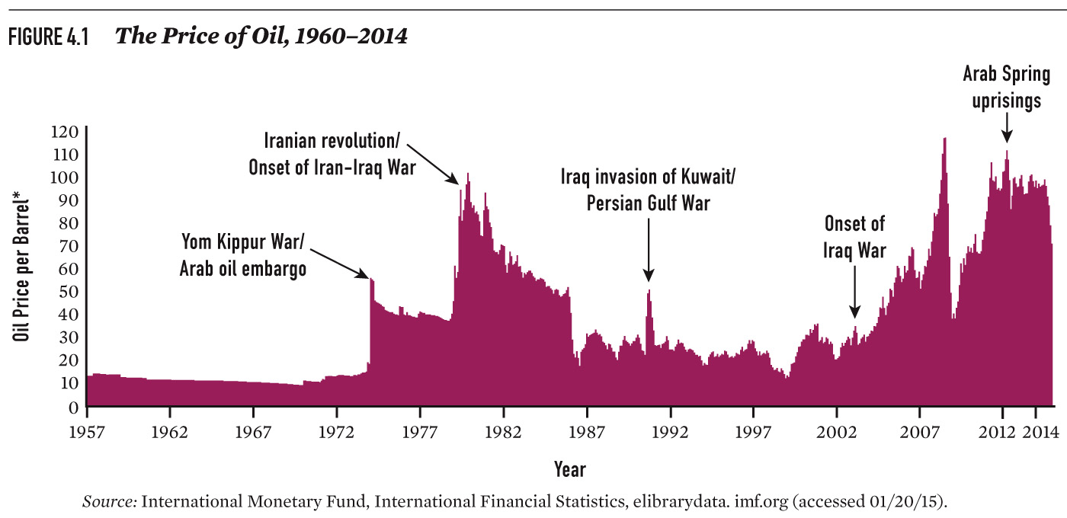
Domestic Politics and War
Notes:
Figure 4.1: The Price of Oil, 1957–2012
This graph depicts the price of oil from 1957 to 2012 and wars in the Middle East.
Some argue that U.S. interventions here are in the broad national interest for both security and economic reasons.
Both our military and our civilian economy depend on reliable supplies of oil from this region.
Others argue that these interventions resulted from the influence of more particularistic interests, namely U.S. oil companies.
In this perspective, U.S. foreign policy in the region is shaped by oil companies’ interests. For example, the United States must defend “friendly” regimes such as Saudi Arabia so that U.S. companies can continue to do business there.
This lecture will explore how the internal characteristics of states can contribute to war.

Slide 19
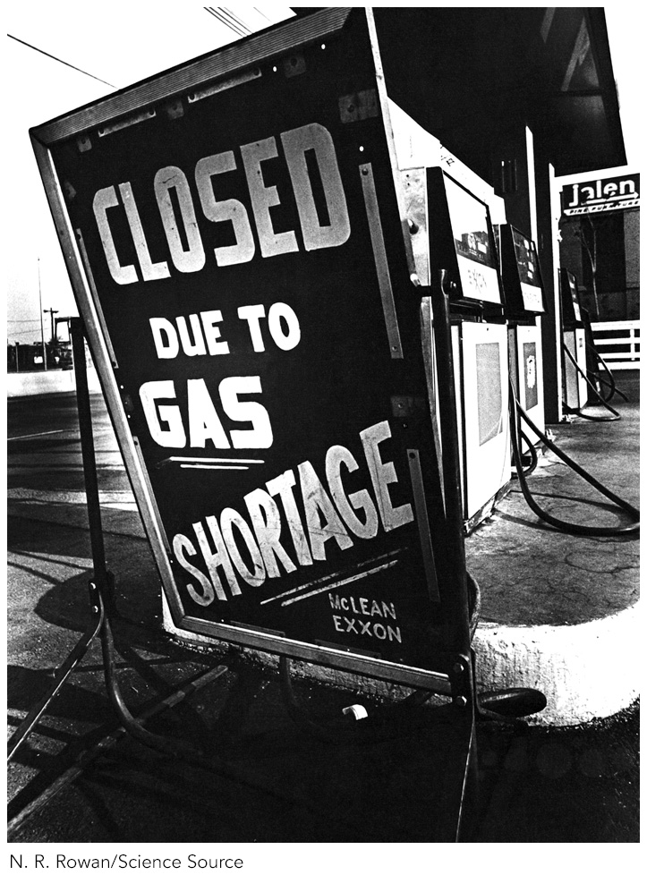
Domestic Politics and War

Slide 20
Domestic Politics and War
Can internal characteristics of states explain why states go to war?
Notes:
Domestic institutions help determine who runs government, how decisions are made and disputes resolved.
Domestic institutions can concentrate decision-making power, or establish checks and balances on power.
Some countries are ruled by autocrats, others by elected representatives.
Domestic institutions shape both incentives for and constraints on opting for war.

Slide 21
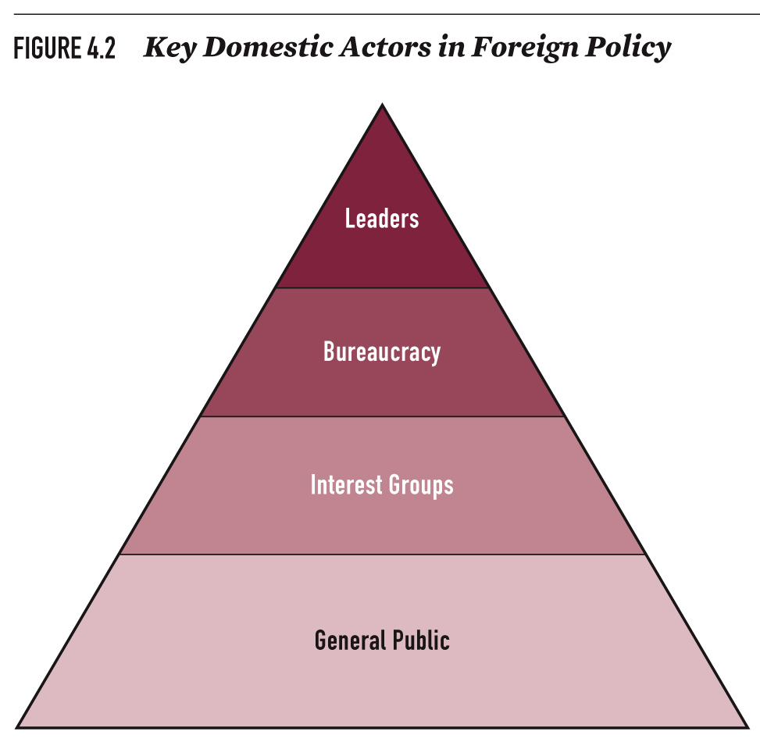
Domestic Politics and War
Notes:
The four types are:
LEADERS who make foreign policy decisions
Organized GROUPS: bureaucratic actors (military, state department)
Interest Groups (especially economic interest groups and ethnic lobbies)
The general public

Slide 22
Leaders and War
Do leaders ever spark war to keep power at home?
How does the “rally round the flag” effect alter the bargaining range?

Slide 23
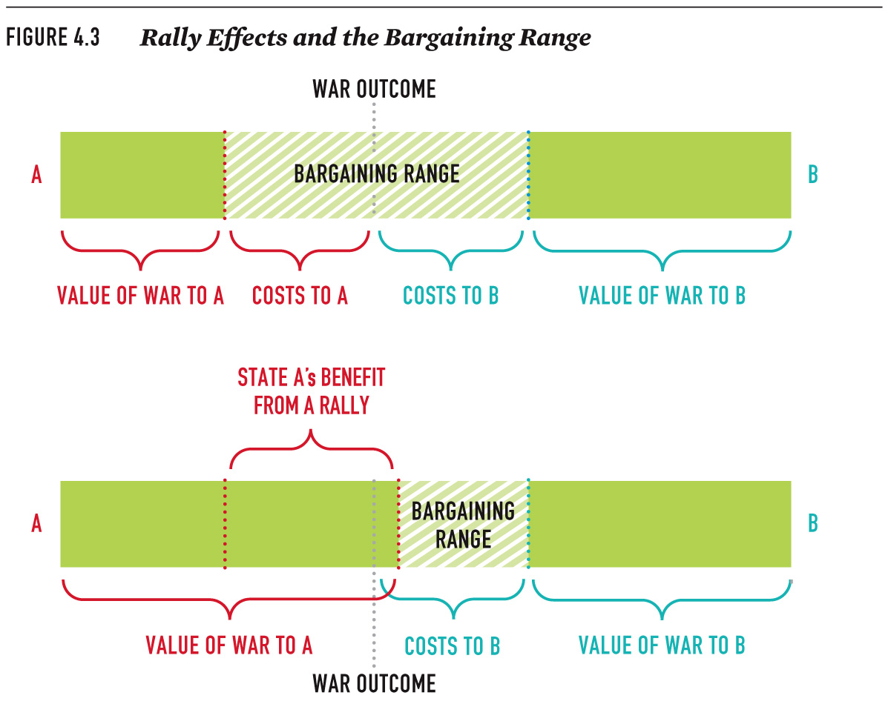
Leaders and War
Notes:
Rally Effects and the Bargaining Range
Rally effect: A short-term boost in government approval from a foreign policy crisis.
Both democratic and nondemocratic leaders may seek the rally effect:
- rally for reelection
- rally to reestablish legitimacy if nondemocratic

Slide 24

Leaders and War
Deals that A prefers to war
Deals that B prefers to war
Red line = bargaining range
Notes:
Here is a simple depiction of the bargaining range in the absence of the rally effect.

Slide 25

Leaders and War
Bargaining range when rally effect added to A’s payoffs
Notes:
Here is how the rally effect can influence the bargaining range.
Political benefits from war mean that state A can demand a better deal from state B. The bargaining range is now closer to A’s ideal point.

Slide 26
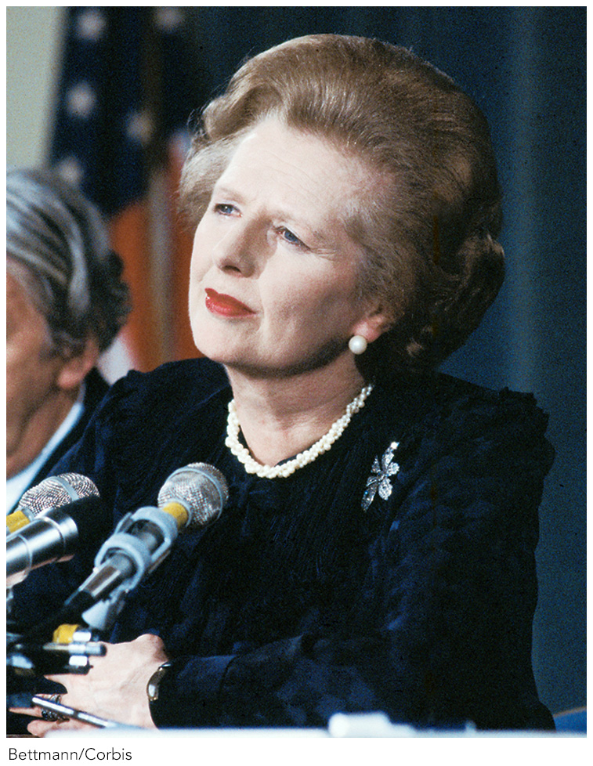
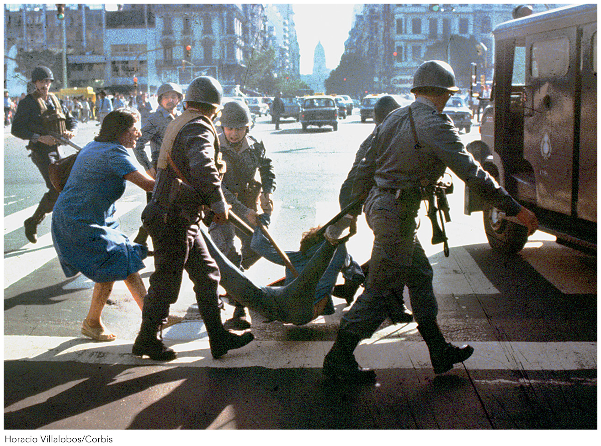
Leaders and War
Notes:
(L) Just a few days before invading the Falkland Islands, the Argentine government faced massive protests and calls for the overthrow of the ruling junta. Rioters confronted police, and thousands were arrested. The war with Britain provided the Argentine junta a (temporary) reprieve from these problems by shifting the public’s attention away from domestic issues.
(R) Thatcher decided to wage war with Argentina over the Falkland Islands—it distracted the public from the severe economic recession of 1982. Her public approval ratings went from 29 percent before the war to 51 percent during the war. The public rallied behind the leader.
Despite a few well-known examples, little evidence shows that leaders start wars to generate a rally.
Secure leaders might be more likely to initiate a crisis.
Benefits of war to a leader must outweigh the benefits of peace.

Slide 27
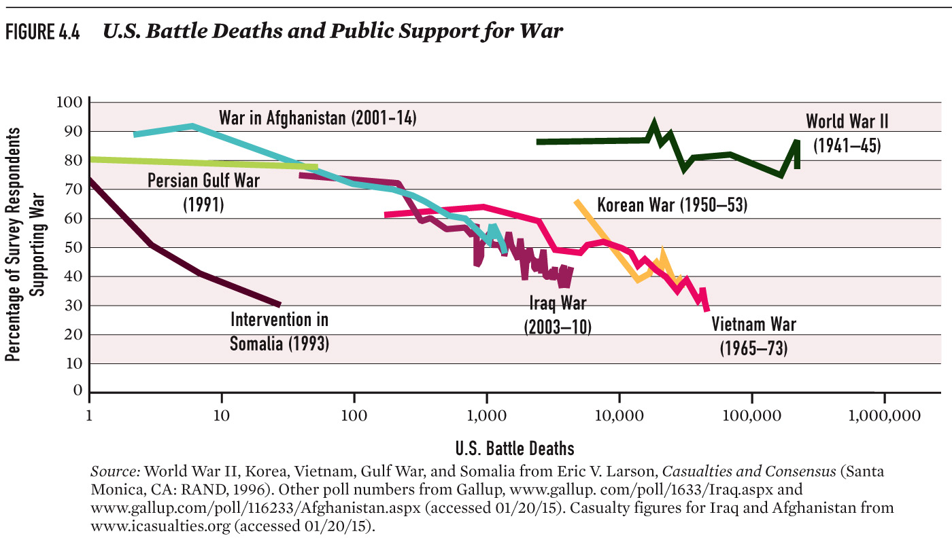
Leaders and War
Notes:
Figure 4.4: U.S. Battle Deaths and Public Support for War
Public support for war wanes as costs in blood and treasure mount.

Slide 28
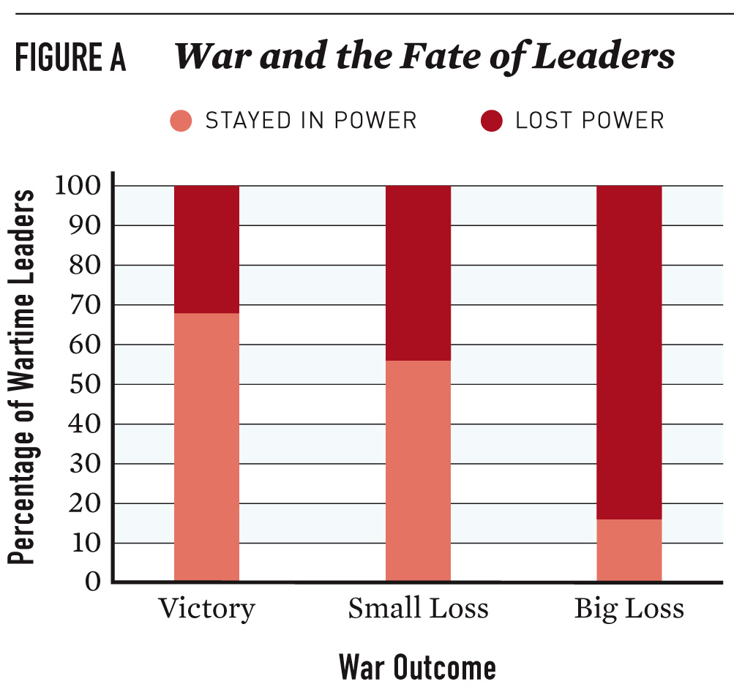
Leaders and War
Notes:
Figure 4.A: War Outcomes and the Fate of Leaders
War is politically costly.
This figure shows that 85 percent of leaders who lost costly wars were out of power within one year of the end of the war.
More than two-thirds who won wars stayed in power.

Slide 29
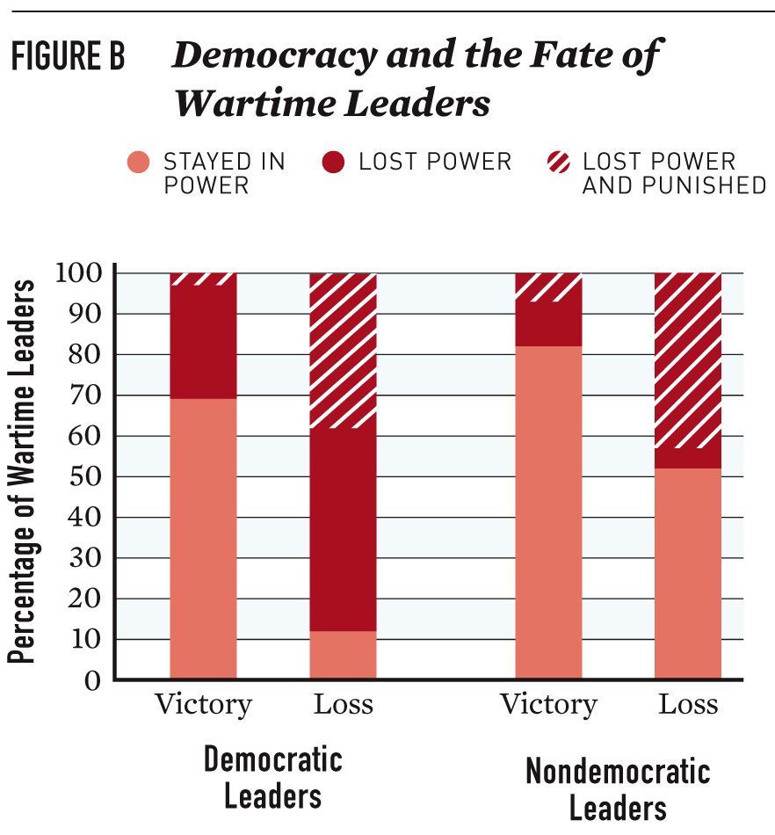
Leaders and War
Notes:
Figure 4.B: Democracy and the Fate of Wartime Leaders
Wars are especially risky for leaders in democracies.
Democratic leaders who lead their countries to war (whether they won or lost) are much more likely to lose office within a year of the war’s end.
Fifty-two percent of nondemocratic leaders stayed in office, and just over 10 percent of democratic leaders did after a loss.

Slide 30
Domestic Groups and War
War may serve the interests of some domestic groups.
Groups may have selfish interests contrary to national interests.
Types of groups
Notes:
Groups may have preferences that differ from the “national interest.”
They may be ideologically opposed to or supportive of a government’s foreign policy.
Some groups may benefit from war. Their view of costs and benefits may differ from the national interest.
For example, many people argued that Halliburton benefited financially from the Iraq War in 2003.
President Eisenhower, in his farewell speech, warned Americans of the dangers of the “military-industrial complex.”
War might be good for the military’s bottom line and bureaucratic interests.
Types of groups
- Political parties
- Economic interest groups
- Ideological or ethnic interest groups
- Bureaucratic interests

Slide 31
Domestic Groups and War
Collective action
  Smaller groups tend to be better organized.
  Larger groups suffer from free riding.
  Groups may shape policy to support their narrow interests
Notes:
How can groups with particularistic preferences prevail?
Logic of collective action:
Smaller groups will be better organized and thus more influential.
Larger groups suffer from free riding (e.g., consumers).
In aggregate, groups will prevail in shaping policy according to their disparate and narrow interests at the expense of a unified national interest.

Slide 32
Domestic Groups and War
War to satisfy the military or interest groups
Costs fall on society as a whole;
benefits may accrue a specific group
Notes:
The military may favor war.
- Its purpose is to wage war.
- War leads to increased budgets.
- War also leads to promotion opportunities.
The military is the most important bureaucratic actor in decisions about war. The military also has the best information about capabilities and resolve.
Yet, in practice, the military often tends to be cautious about going to war.
U.S. military was far more reluctant to go to war with Iraq in 2003 than were the White House and the civilian leadership at the Pentagon.

Slide 33
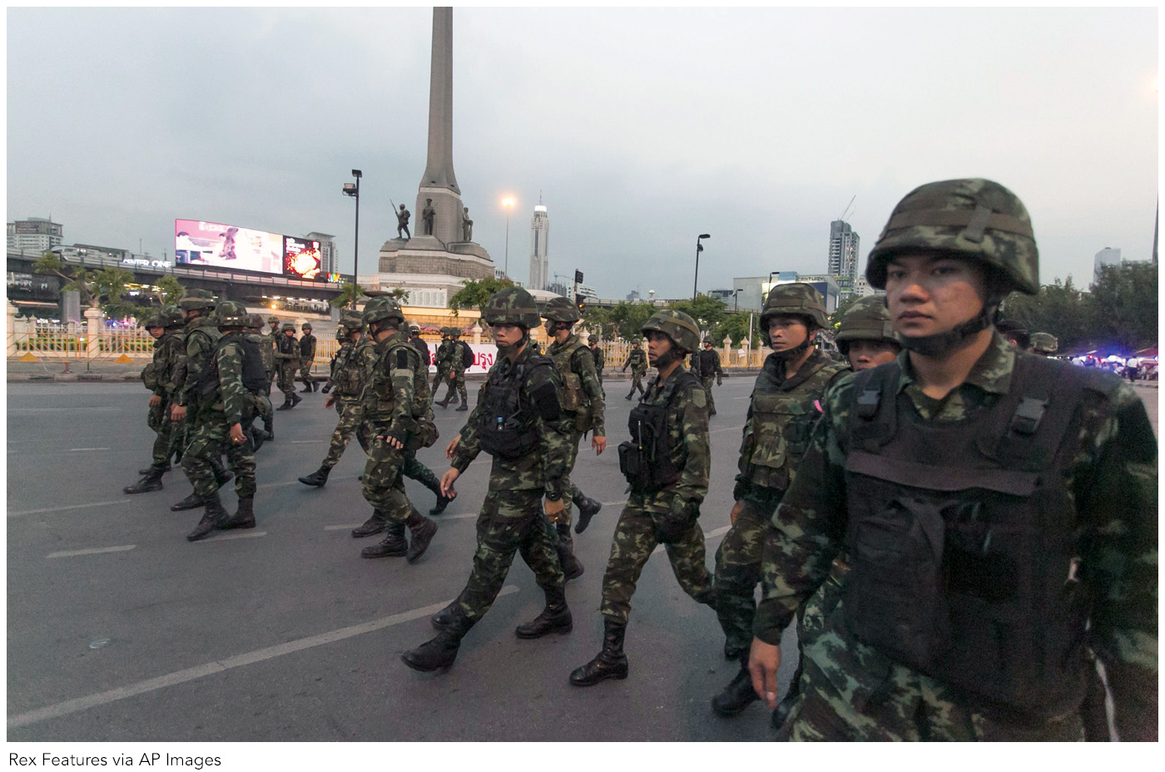
Domestic Groups and War
Notes:
In May 2014, the military staged a coup and ousted the Thai government. When governments have to depend on the military to stay in power, the military has substantial influence over its foreign policy.

Slide 34
Hawks and Doves
Hawks favor war.
Doves oppose war.
Notes:
How do domestic interests affect the bargaining range?

Slide 35

Hawks and Doves
Bargaining with dovish interests in state A

Slide 36

Hawks and Doves
Bargaining with hawkish interests in state A
Notes:
Bargaining with hawkish interests in state A narrows the bargaining range.

Slide 37
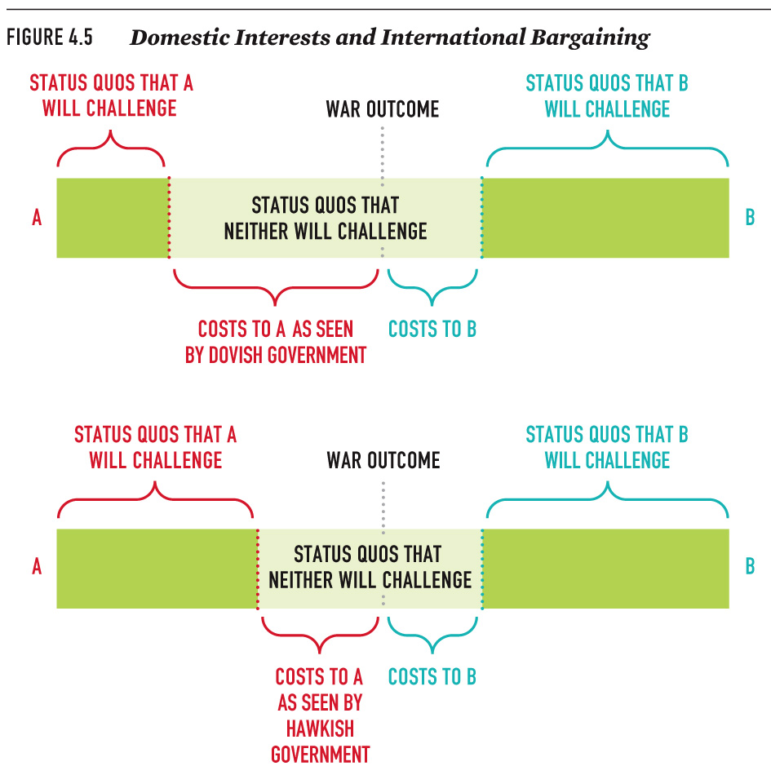
Hawks and Doves
Notes:
Figure 4.5: Domestic Interests and International Bargaining
Interactions between groups favoring and opposing war can alter states’ interests, but this alone does not usually lead to war.

Slide 38
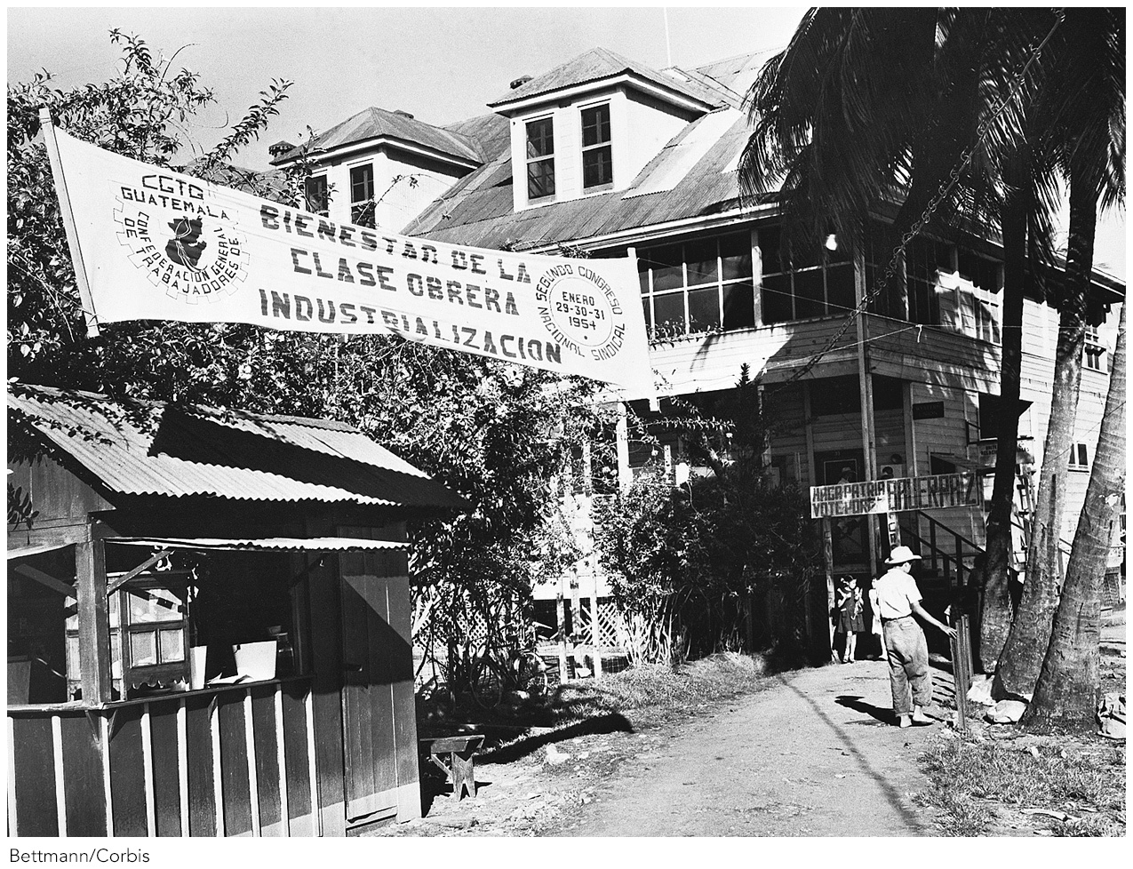
Domestic Groups and War
Notes:
Business groups may try to influence foreign policy to protect their interests. When the Guatemalan government seized extensive property belonging to the United Fruit Company in 1954, arguing that it belonged to the workers of Guatemala, United Fruit asked the U.S. government to intervene. Here, a banner with slogans from Guatemala’s General Confederation of Workers hangs in front of a United Fruit hiring hall. The CIA worked to topple Arbenz and installed a pro-American leader in his place.

Slide 39
Domestic Politics and War
War Model Review
Domestic Politics and War
Institutions and War

Slide 40
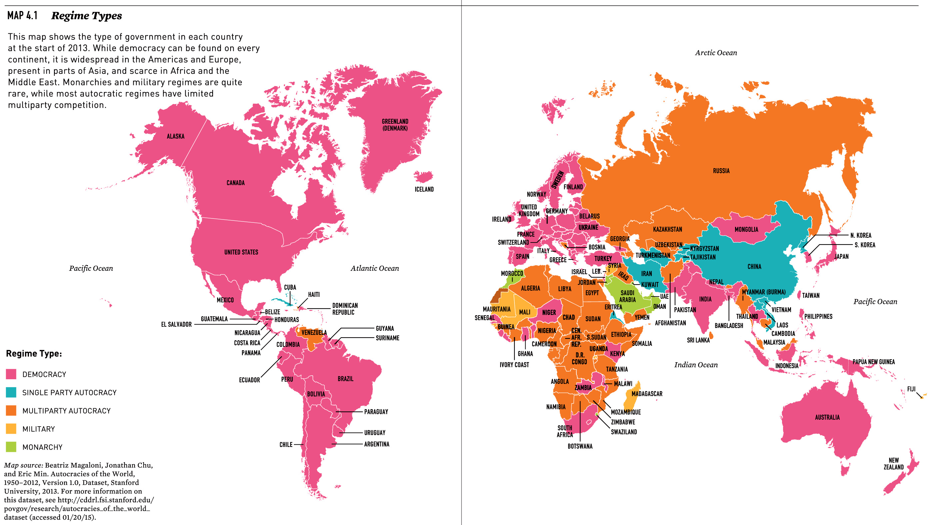
Institutions and War
Notes:
Does a country’s regime type affect the likelihood of war?
Autocracies
Most common form of nondemocratic system today is “electoral authoritarianism” that all but ensures victory for the ruling party.
Venezuela, Russia, Ethiopia, and Myanmar.

Slide 41
Institutions and War
Are democracies less prone to go to war?
Features of democracies
Notes:
Democratic institutions may discourage war.
- Forces consensus between elite and masses
- Leaders accountable
- Masses bear costs
- Promotes norms of negotiation
However, the democratic process is slow, and leaves time for interstate bargaining.

Slide 42
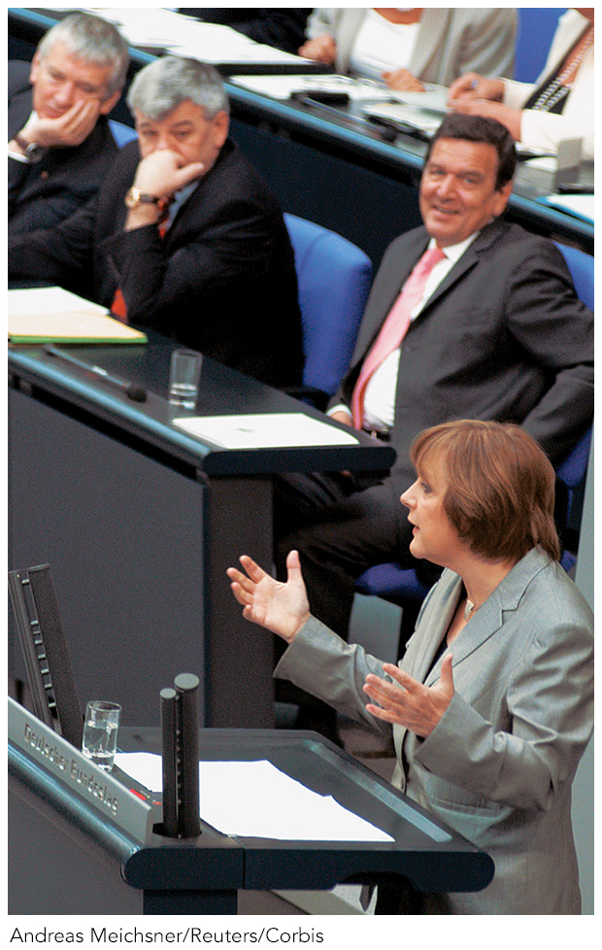
Institutions and War
Notes:
Mature liberal democracies do not fight each other. They are also more transparent than other forms of government. This helps actors overcome information problems that can lead to war.
Although France and Germany were once bitter enemies, they now cooperate closely, and war between them has become virtually unthinkable. Some scholars attribute this to the fact that both countries have had democratic governments since they last fought, in World War II.
Here, German chancellor Angela Merkel and former French president Nicolas Sarkozy wind up a press conference at the Franco-German Ministers Council in November 2008.
Horacio Villalobos/epa/Corbis

Slide 43
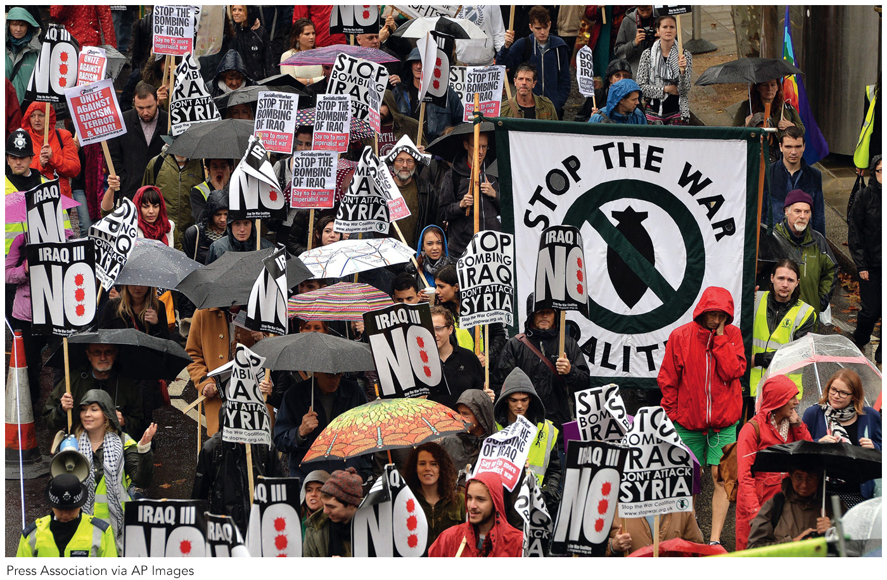
Institutions and War
Notes:
The German government’s decision to stay out of the Iraq War may have come about because 2003 was an election year, and large groups of German voters opposed the war. Thousands of Germans protested the war in Berlin and other major cities. In democratic systems, voters can influence foreign policy by removing or threatening to remove leaders who make unpopular decisions. In liberal democracies, the general public can influence the decision to enter or stay out of a war.
Reuters/Corbis

Slide 44
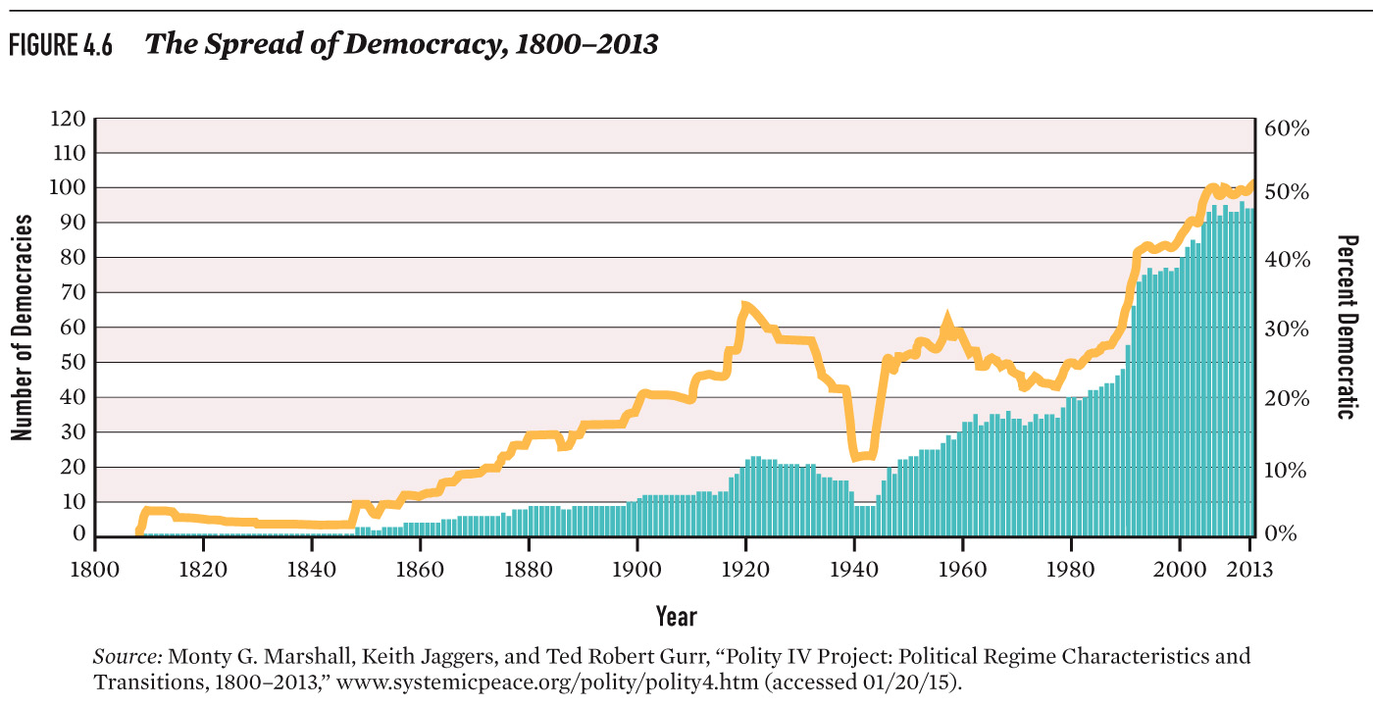
Institutions and War
Notes:
Figure 4.6: The Spread of Democracy, 1800–2010
Limits to the democratic peace thesis.
The spread of democracy may not lead to world peace.
The transition to democracy may increase the probability of war.
Instability of young democracies
- Maybe peace between mature democracies is a function of common interests, economic development, or the fact that war is rare, rather than a function of regime type.
- Democratic rule may empower groups, like the United Fruit Company, that face huge gains from war.

Slide 45
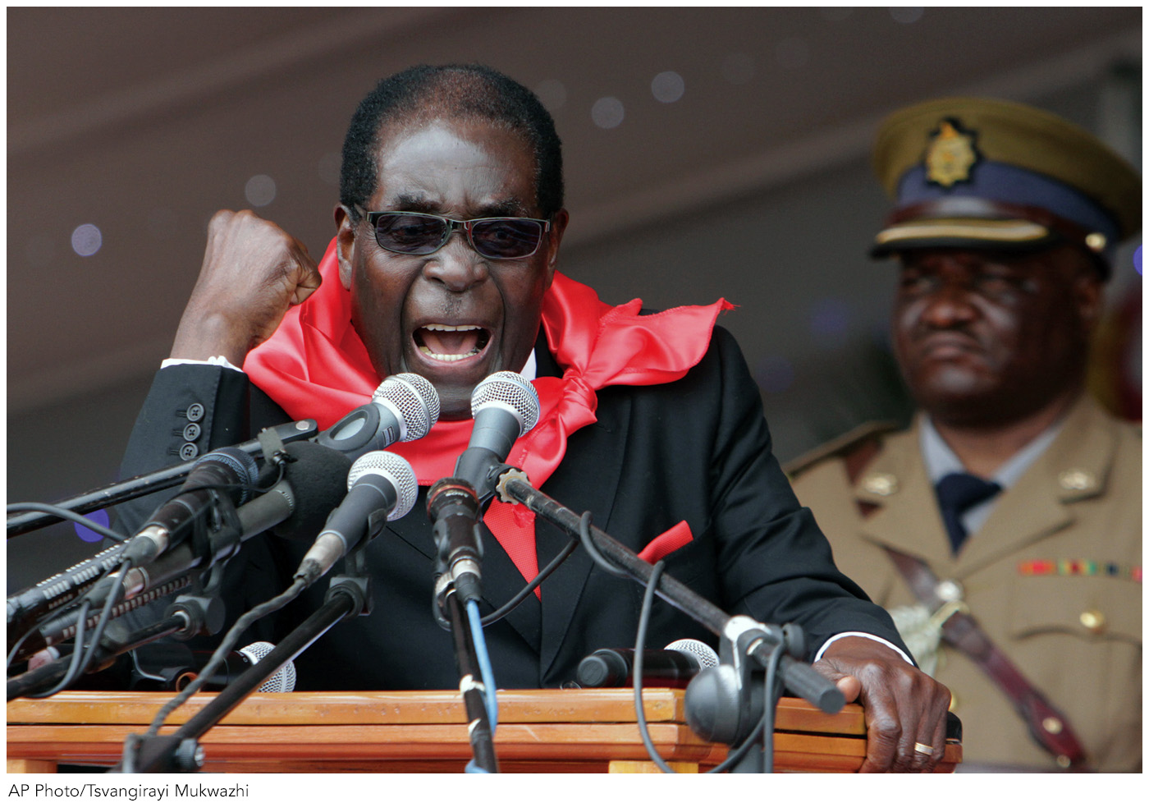
Institutions and War
Notes:
In nondemocratic states, like Zimbabwe, a small group of leaders typically makes foreign policy behind closed doors, often limiting what can be reported to the media and the public. This lack of transparency can make it harder for foreign states to gauge the state’s capabilities and resolve.
Democracies are just as likely to go to war with nondemocracies.
- For example, Iraq and Afghanistan
- Demands of nondemocracies are not always seen as legitimate.
- Dictators can engage in riskier behavior.
- Lack of transparency makes it hard for foreign states to gauge capabilities and resolve.

Slide 46
Summing Up
Some domestic actors may see benefits from war and expect to bear few costs.
These actors have institutional and organizational advantages that allow them to exert influence.
Hawkish interests are not sufficient to cause war on their own.
Free and fair elections, party competition, and free media can tamp down hawkish interests.

Slide 47
Additional art from the text follows this slide

Slide 48
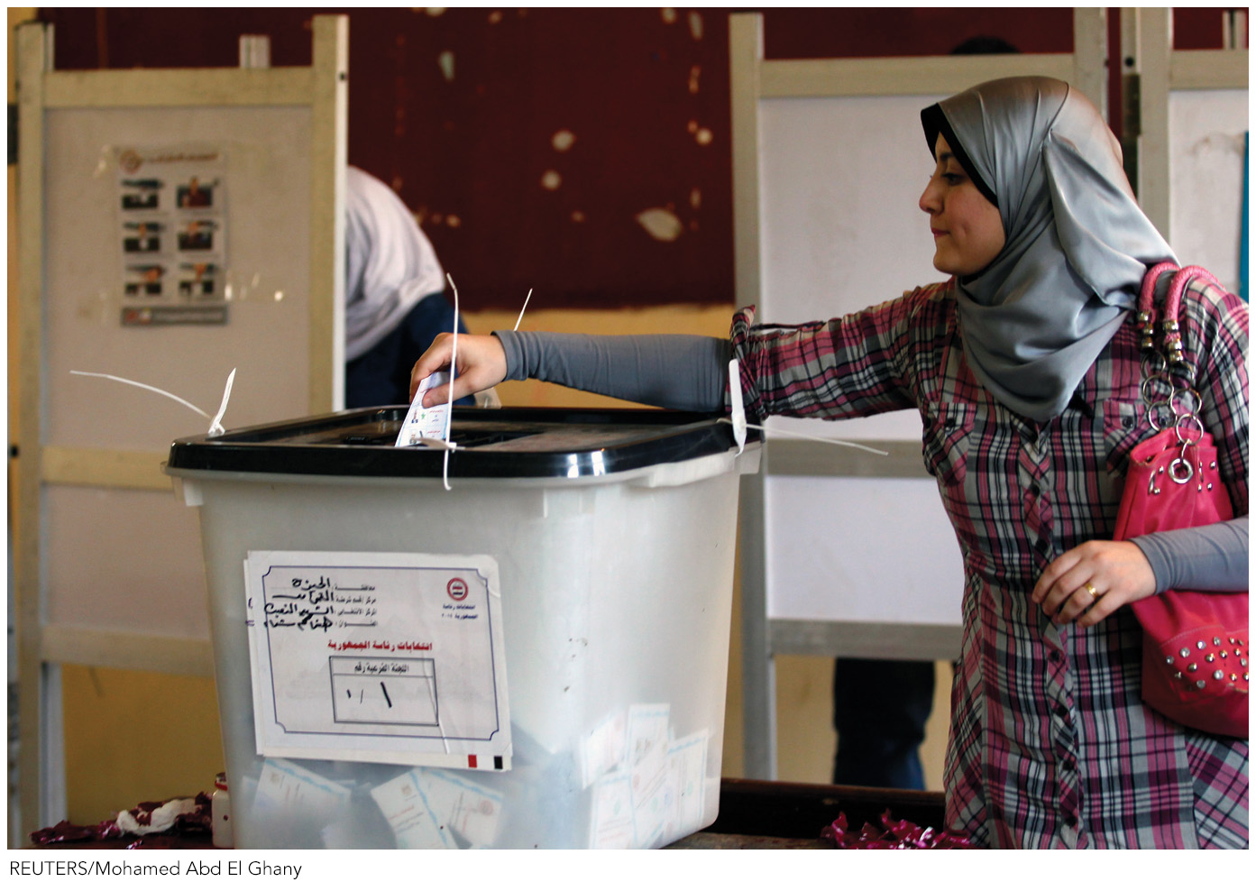
Notes:
Should We Prefer a Friendly Dictator or a Hostile Democracy?

Slide 49

Notes:
Should We Prefer a Friendly Dictator or a Hostile Democracy?

Slide 50
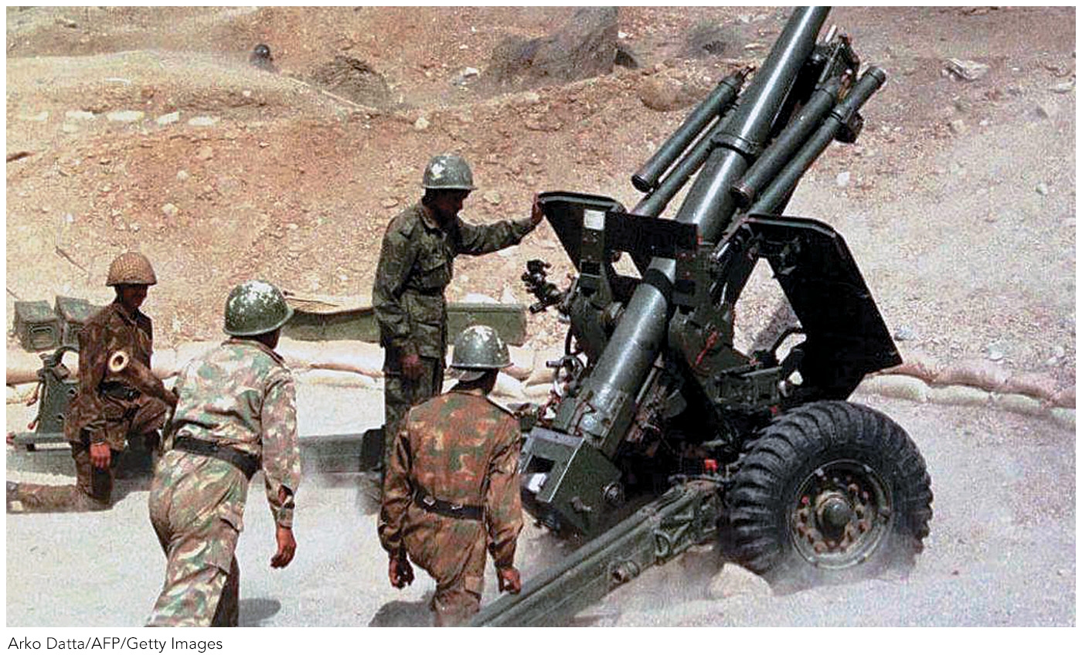
Notes:
The Kargil War and Military Influence in War

